Slide 1


Slide 2


For repeated or regular actions in the present time period.
I take the train to the office.
2. For facts.
A dog has four legs.
3. For habits.
I get up early every day.
4. For things that are always / generally true.
It rains a lot in winter.

Slide 3



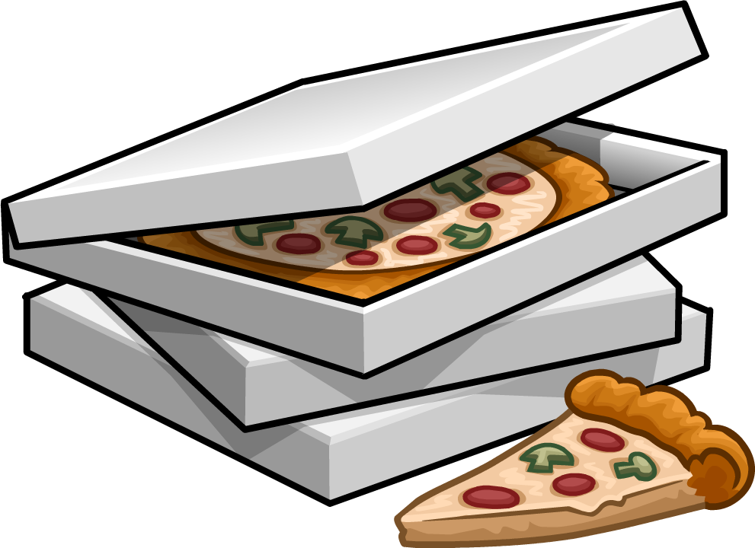

Subject + verb to be + complement
I am a teacher
You are a student
He/she/it is happy
We are friends
They are brothers
Subject + verb + complement
I eat pizza
You eat pizza
He/she/it eats pizza
We eat pizza
They eat pizza
Subject + verb to be +not + complement
I am not a teacher
You are not a student
He/she/it is not happy
We are not friends
They are not brothers
Subject + don’t/doesn’t + verb + complement
I don’t eat pizza
You don’t eat pizza
He/she/it doesn’t eat pizza
We don’t eat pizza
They don’t eat pizza
Verb to be + subject + complement?
Am I a teacher? (Yes, I am // No, I’m not)
Are you a student? (Yes, I am // No, I’m not)
Is he/she/it happy? (Yes, he is// No, he isn’t)
Are we friends? (Yes, we are// No, we aren’t)
Are they brothers? (Yes, they are // They, aren’t)
Do/Does + subject + verb + complement?
Do I eat pizza? -> (Yes, I do. // No, I don’t)
Do you eat pizza? (Yes, I do. // No, I don’t)
Does he/she/it eat pizza? (Yes, he does. // No, he doesn’t)
Do we eat pizza? (Yes, we do// No, we don’t)
Do they eat pizza? (Yes, they do// No, they don’t)

Slide 4


For verbs that end in -O, -CH, -SH, -SS, -X, or -Z we add -ES in the third person.
go – goes
catch – catches
wash – washes
kiss – kisses
fix – fixes
buzz – buzzes
2. For verbs that end in a consonant + Y, we remove the Y and add -IES.
marry – marries
study – studies
carry – carries
worry – worries

Slide 5


I am eat pizza
Pinky promise?

Slide 6



Slide 7
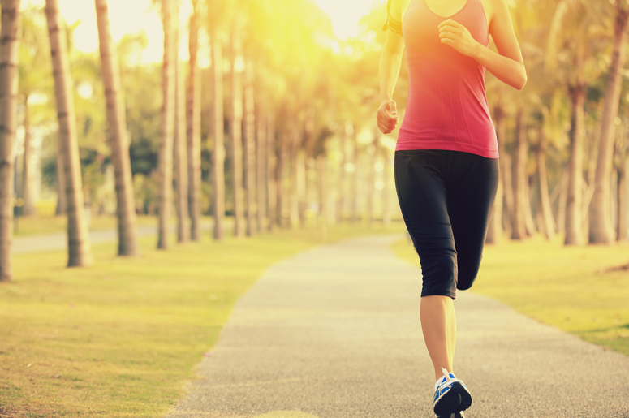
run
I
in the park
I
run
in the park

Slide 8

sing
She
opera
She
sings
opera

Slide 9

eat
You
hamburgers
Do
you eat
hamburgers?

Slide 10
eat
He
hamburgers
He
doesn’t eat
hamburgers

Slide 11
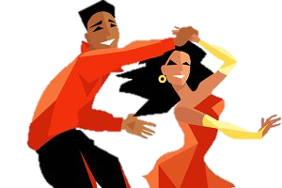
dance
They
salsa
They
dance
salsa

Slide 12

speak
she
Italian
Does
she speak
Italian?

Slide 13


cry
she
with sad movies
She
cries
with sad movies

Slide 14
cry
she
with sad movies
Does
she cry
with sad movies?

Slide 15
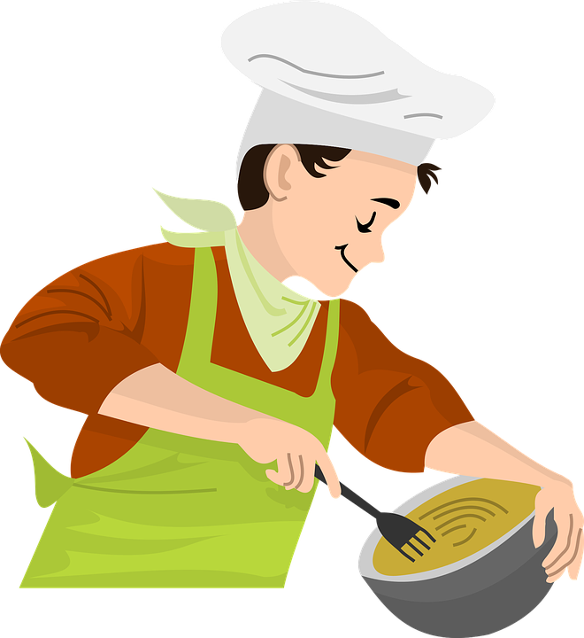
cook
he
pasta
He
cooks
pasta

Slide 16

teach
she
English
She
teaches
English

Slide 17
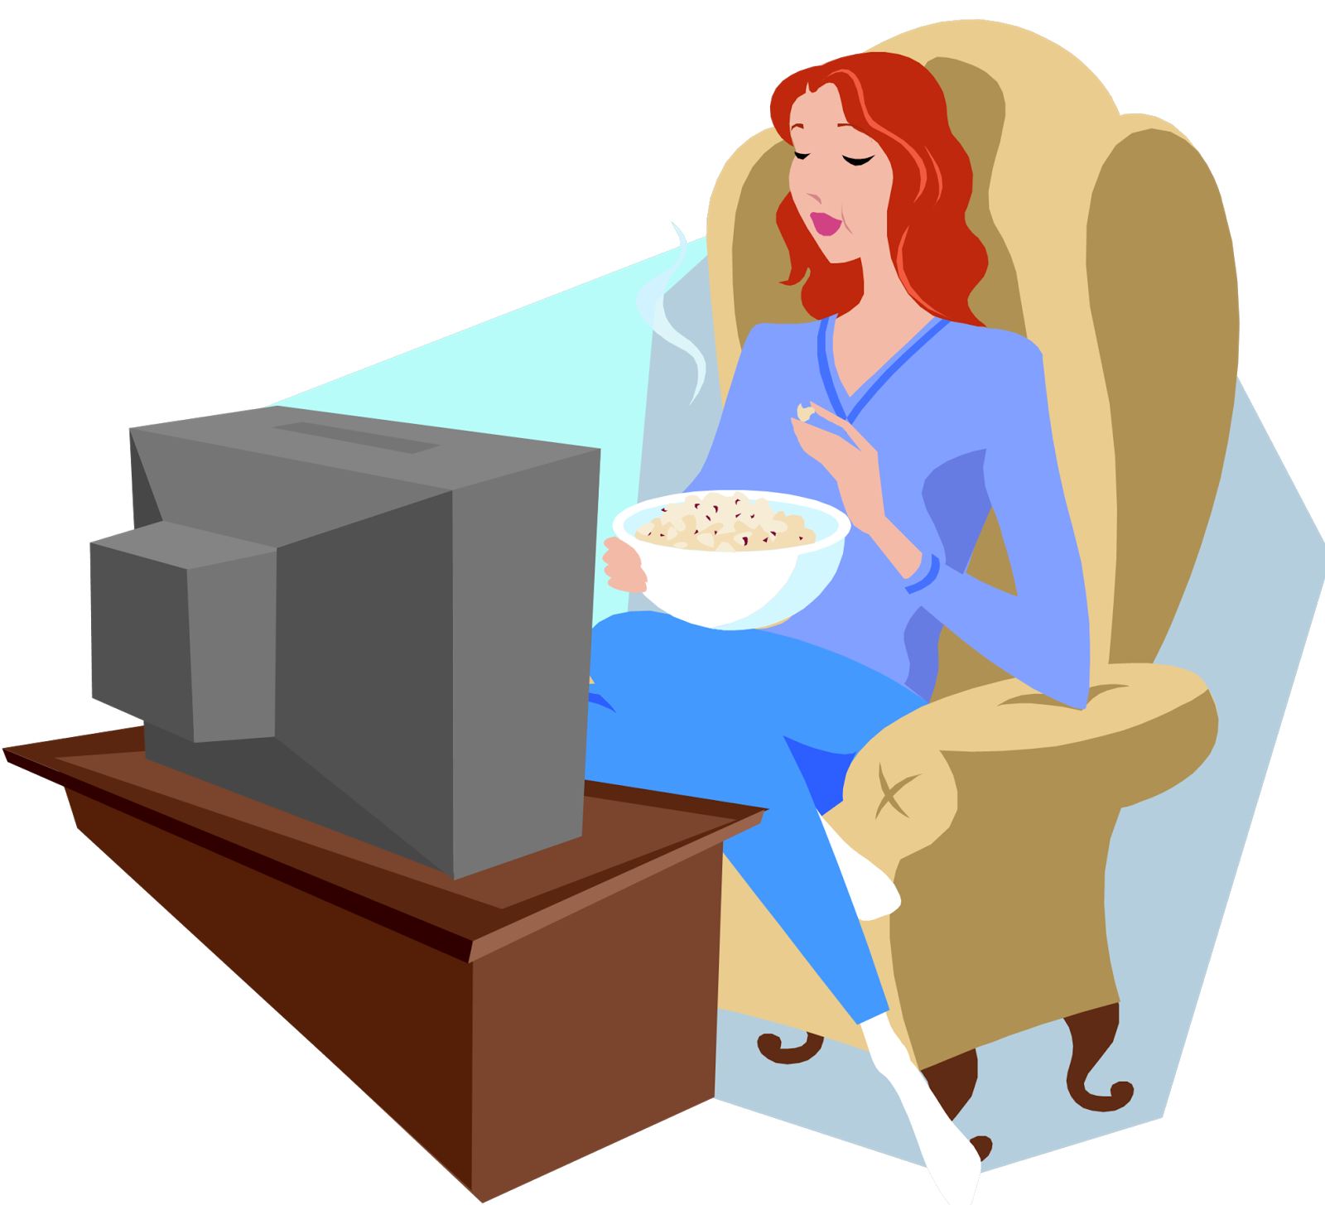
watch
she
TV
She
watches
TV

Slide 18


Slide 19
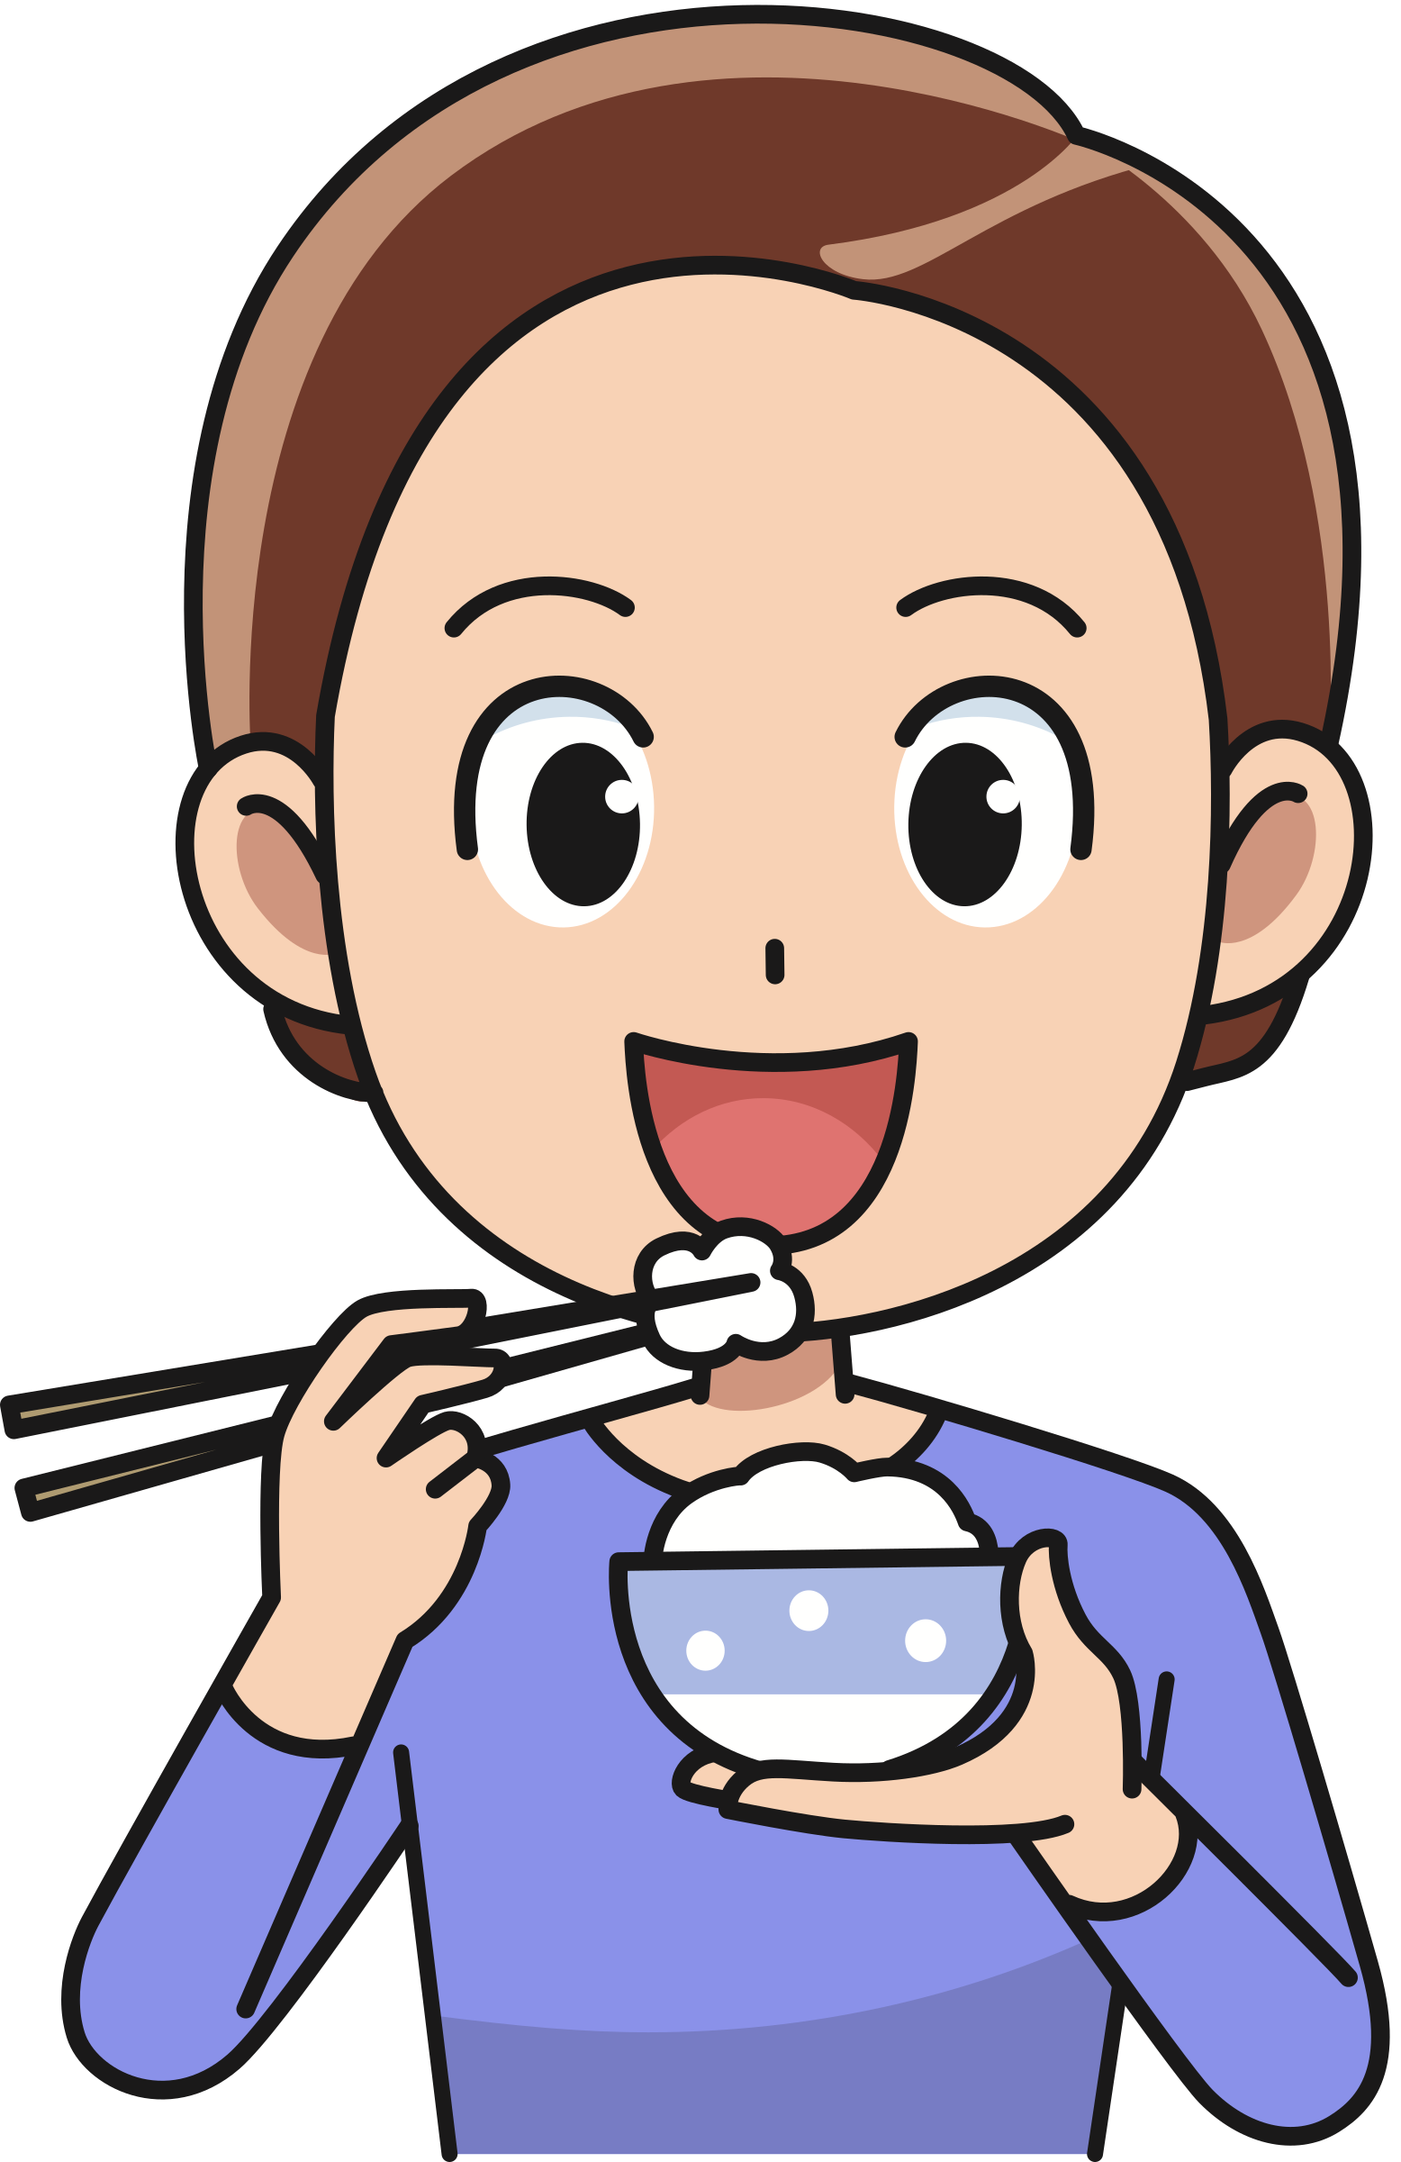


Slide 20
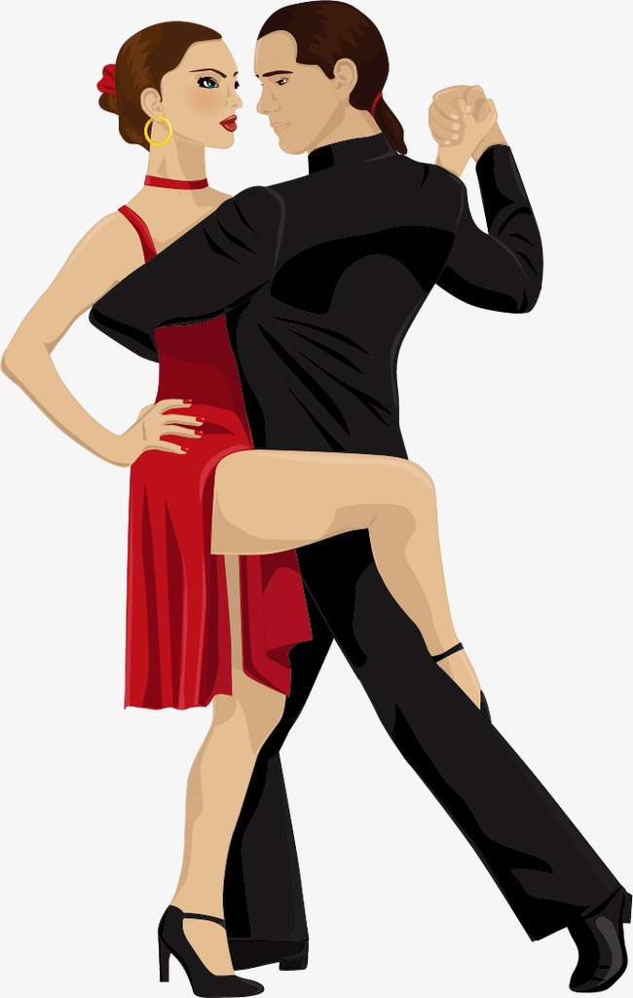

Slide 21
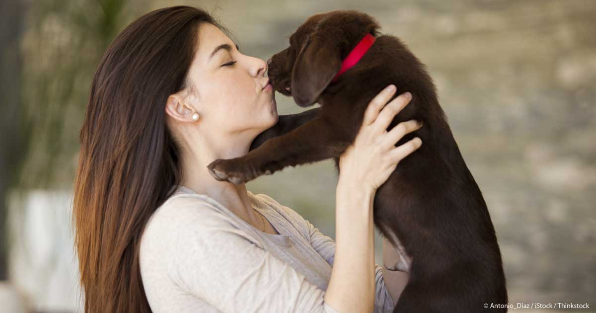

Slide 22
